Slide 1
Assignment:19AIE104 Introduction to Electrical Engineering
SUBMITTED BY GROUP 19
Names of Group members :
1.VIGNESH M. [1008496 ]
2.VIKHYAT BANSAL [1007359]
3. YARRAM SRI SATHWIK REDDY [1038833]
4.AMAN SIROHI [1042496]

Slide 2
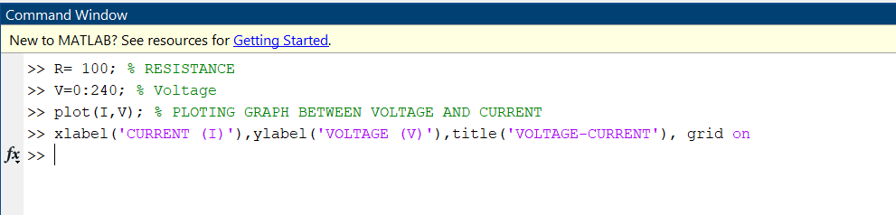
Q1) PART 1: Assume a random value of your choice for resistance (10-10K Ω). Plot the characteristics given below. The resistance coefficient of temperature is 0.02 Ω/°c, and the voltage range is 0-240 V.
• Voltage - Current
FORMULA EXPLANATION :
Relation between current and voltage is expressed as I=V/R
V= voltage, I= current, R= resistance
Let us assume R= 100 for this question

Slide 3

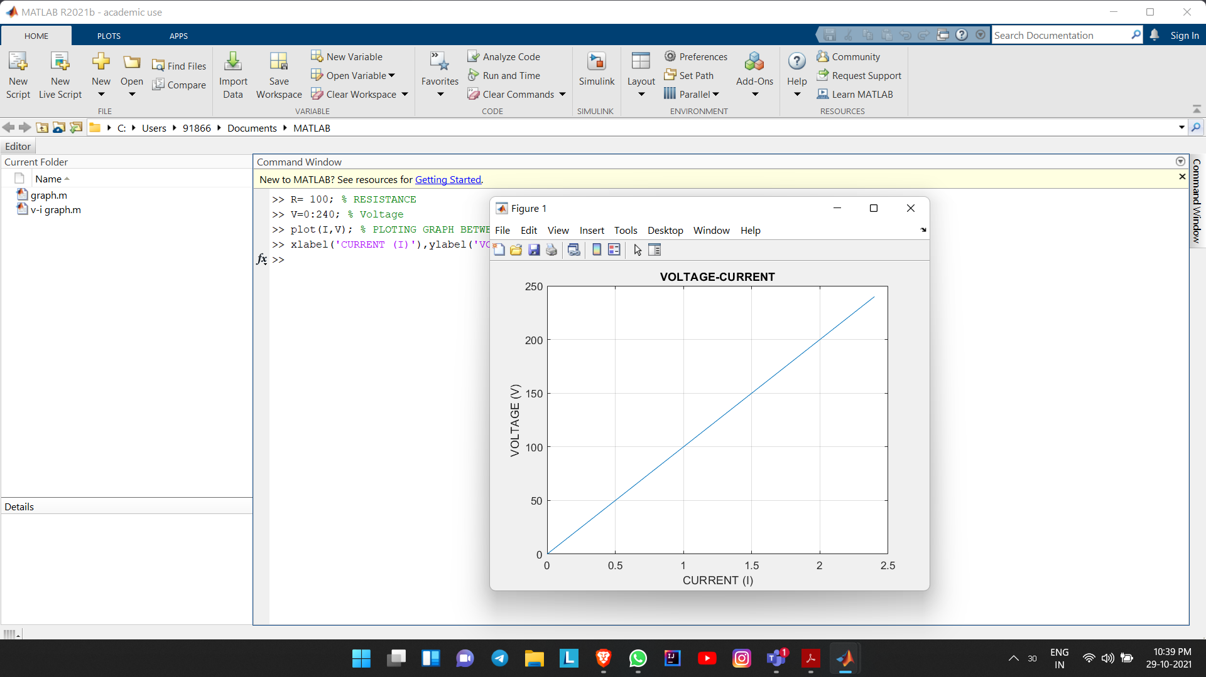

Slide 4

• Power-Voltage
FORMULA EXPLANATION :
Relation between power and voltage is expressed as P= R*(I^2)
By using V=IR relation, we get that
P=(V^2)/R
V= voltage, P= power, R= resistance
Let us assume R= 100 for this question

Slide 5
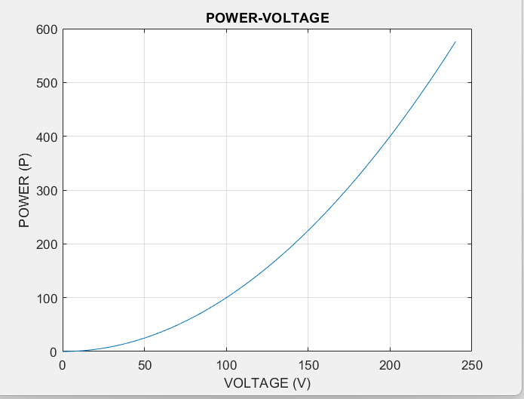

Slide 6

• Power-Current
FORMULA EXPLANATION :
Relation between power and voltage is expressed as P= R*(I^2).
V= voltage, P= power, R= resistance
Let us assume R= 100 for this question

Slide 7
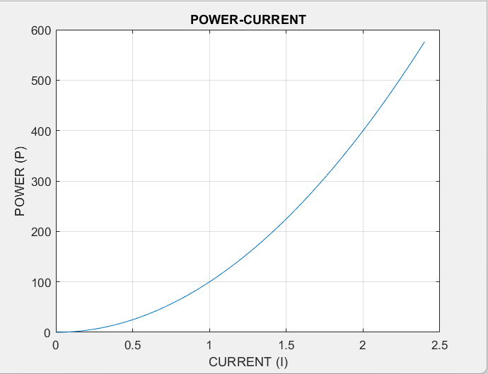

Slide 8
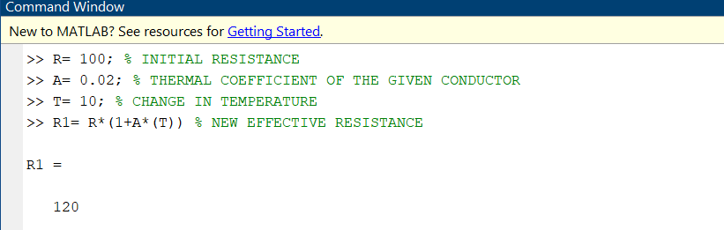
PART 2: Due to prolonged operation, the temperature of the resistance rises by 10°c. Replot the above considering the new scenario
FORMULA EXPLANATION:
R1 = R * ( 1 + A* (T) )
Here,
R1= new effective resistance
A= thermal coefficient of the given conductor
T= change in temperature
R= initial resistance

Slide 9

• Voltage-Current
FORMULA EXPLANATION :
Relation between current and voltage is expressed as I=V/R1
V= voltage, I= current, R1= new effective resistance
We know from our last calculation R1=120Ω

Slide 10
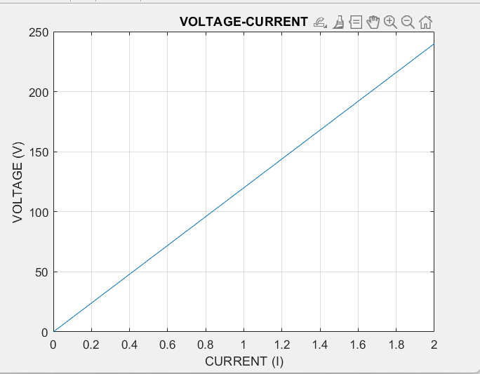

Slide 11

• Power-Voltage
FORMULA EXPLANATION :​
Relation between power and voltage is expressed as P= R1*(I^2)​
​
By using V= I*R1 relation, we get that​
​
P=(V^2)/R​1
​
V= voltage, P= power, R1= new effective resistance​
​
We know from our last calculation R1=120Ω

Slide 12
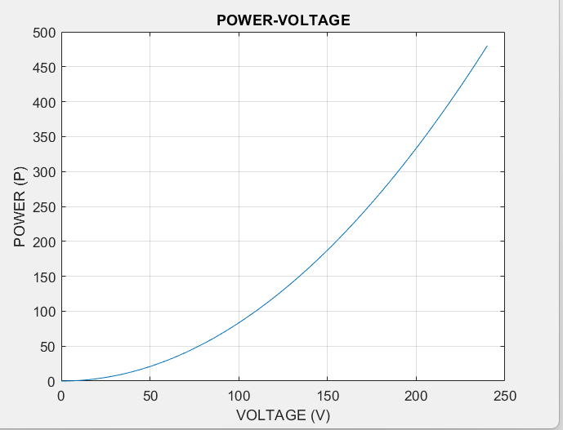

Slide 13
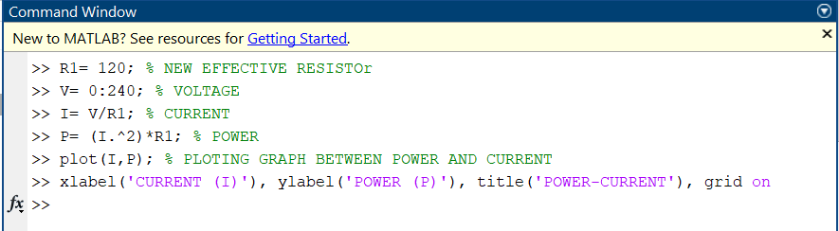
• Power-Current
FORMULA EXPLANATION :​
Relation between power and voltage is expressed as P= R1*(I^2).​
​
V= voltage, P= power, R1= new effective resistance​
​
We know from our last calculation R1=120Ω

Slide 14
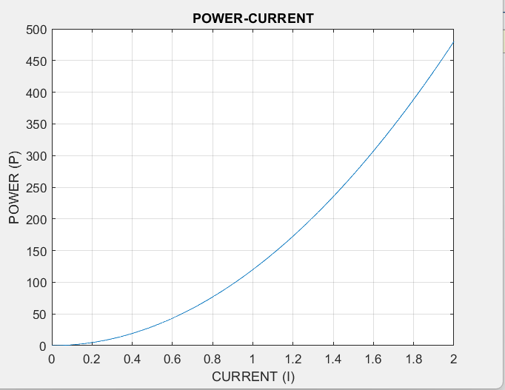

Slide 15
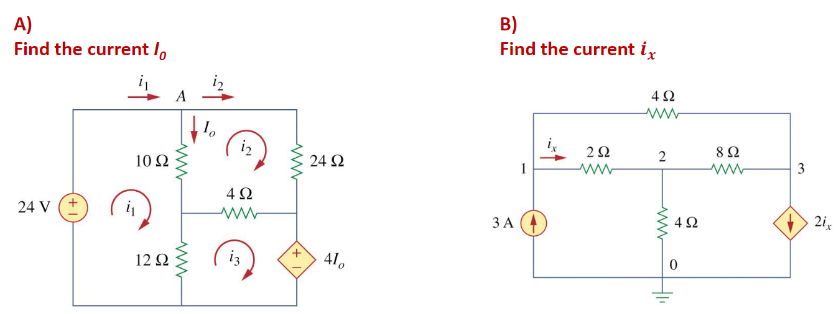
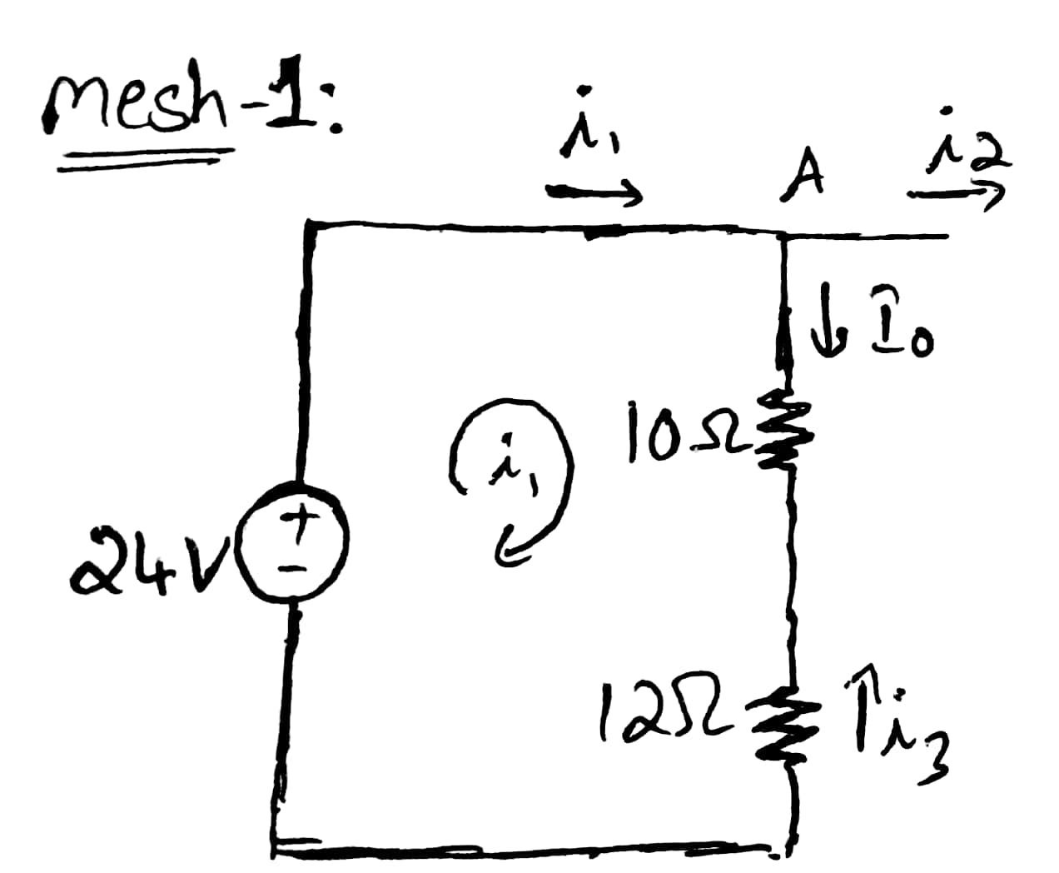
2) Solve the circuits using mesh or nodal network matrices .
A)
We first obtain the mesh currents using KVL.
(*Kirchhoff's Voltage Law)
*KVL(Sum of the voltage difference around any closed loop in
a circuit must be zero)
For mesh 1, Here i₀ = (i₁-i₂)
-24 + 10(i₁ -i₂) +12(i₁ -i₃) = 0
11(i₁) - 5i₂ – 6i₃ = 12 ------(1)

Slide 16
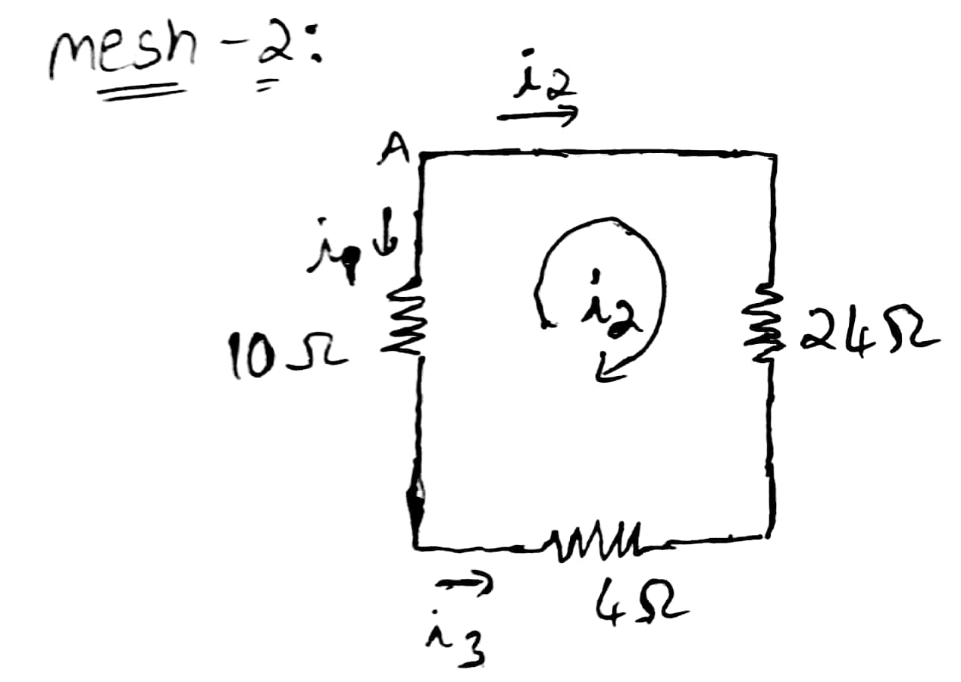
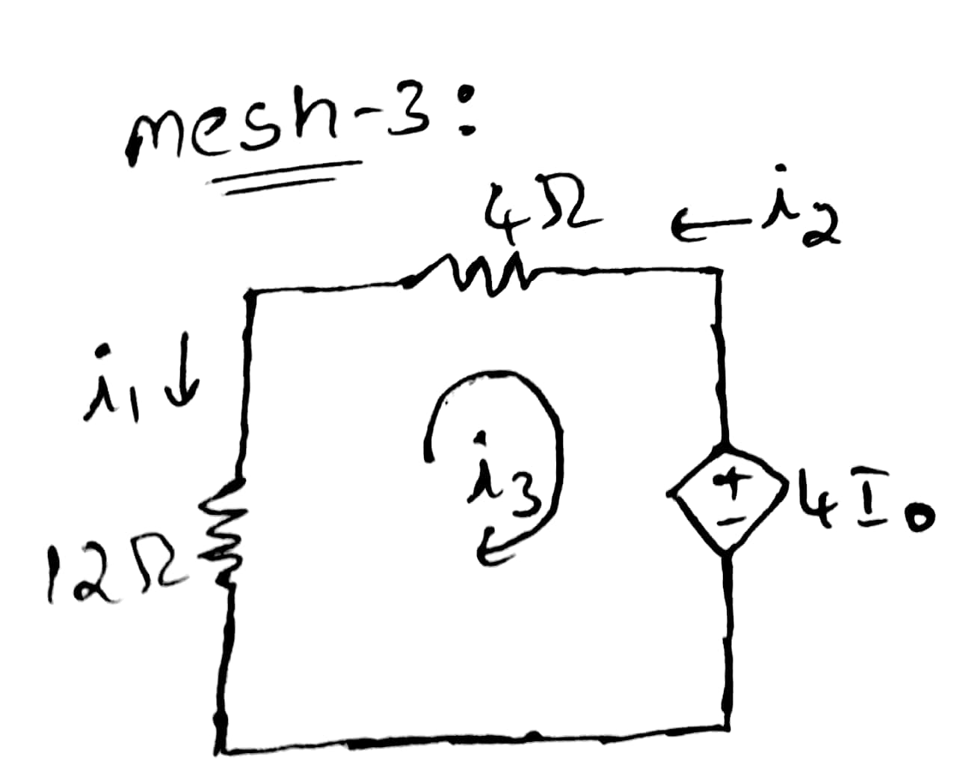
For mesh 2:
24i₂ + 4(i₂ -i₃) +10(i₂ -i₁)
-5i₁ +19i₂ – 2i₃ = 0 ----------(2)
For mesh 3:
4I₀+ 12(i₃ - i₁) + 4(i₃ - i₂) = 0
But here I₀ = (i₁ -i₂)
4(i₁ - i₂) +12(i₃ - i₁) + 4(i₃ - i₂) = 0
-i₁ –i₂ + 2i₃ = 0 ------------(3)

Slide 17
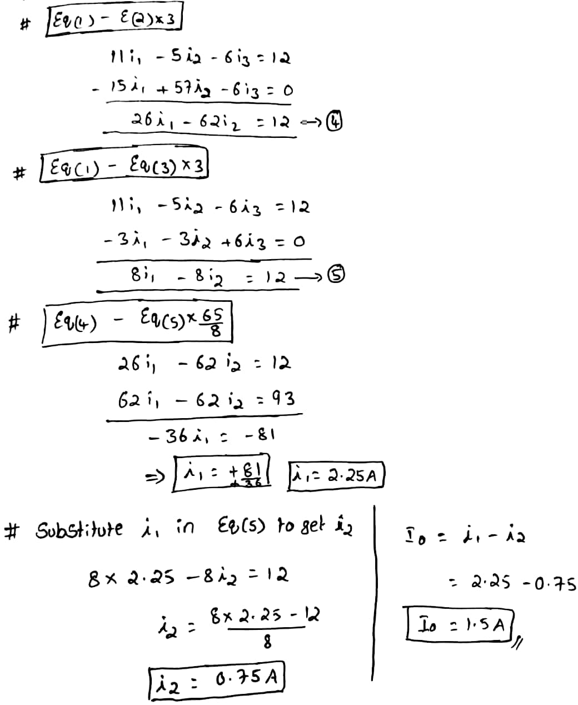
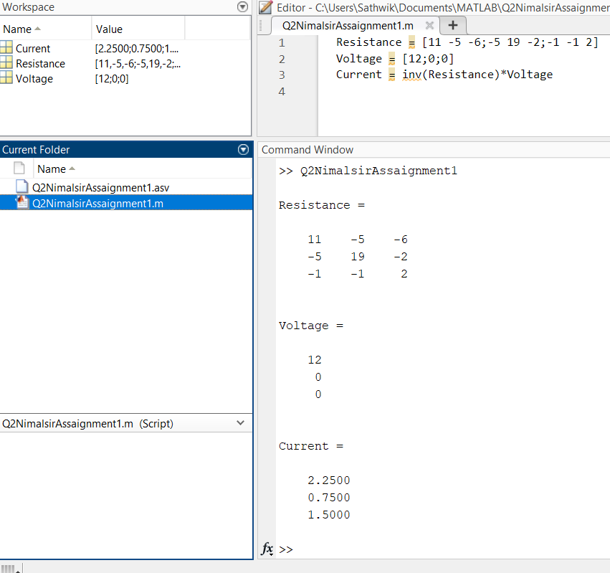
Solving equations 1,2 and 3 to get i₁ , i₂ and I₀ Solving by matrix method using octave /Matlab
* i₁ = 2.25 * I₀ = i₁ - i₂
* i₂ = 0.75 = 1.5
* i₃ = 1.50

Slide 18
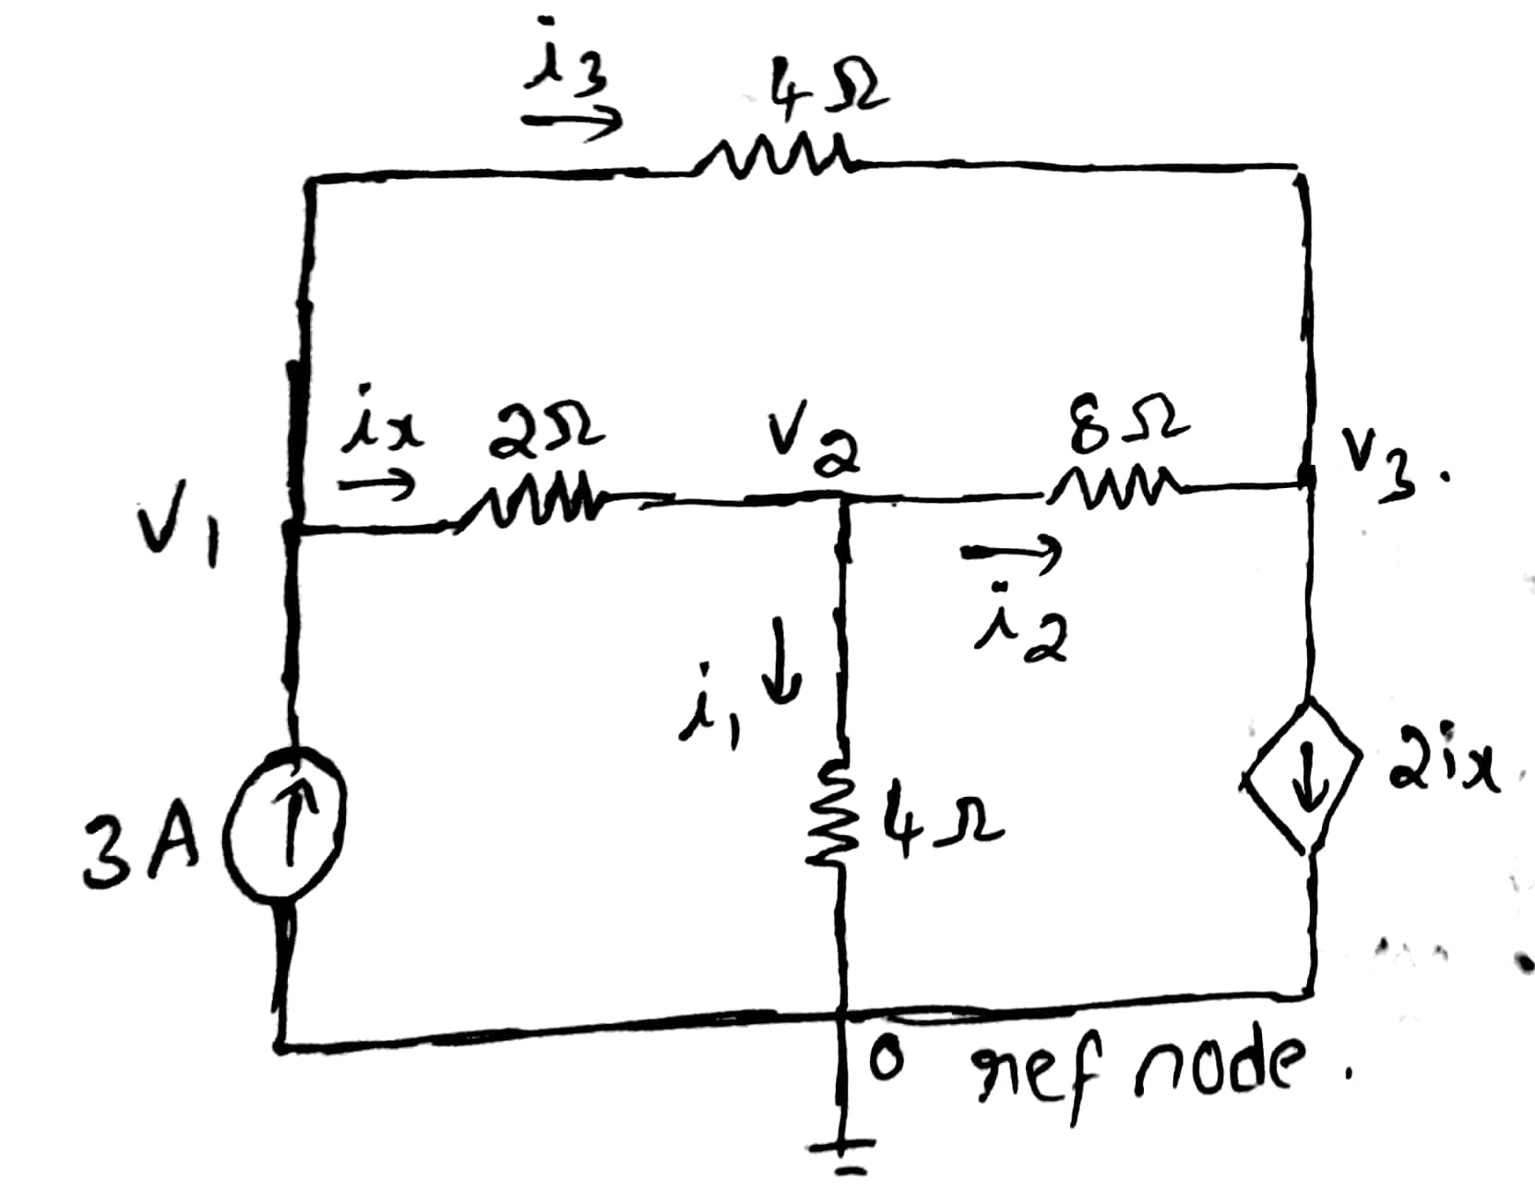
B)
By using Nodal analysis
* Assume that the currents
i₁ ,i₂ ,i₃ is flowing in the
Directions as shown in fig:
* Apply KCL at Nodes v₁, v₂,v₃
* KCL (Summation of current entering at
Node = Summation of the current leaving
the node)
* KCL at node v₁:
3 = i_{x} + i₃ {* Higher voltage – lower voltage}
v₁ –v₂ v₁ – v₃
3 = --------- + ----------- {*multiply by 4 on both sides}
2 4
12 = 3v₁ – 2v₂ –v₃ ------(1)

Slide 19
* KCL at node v₂:
i_{x} = i₁ + i₂ {* Higher voltage – lower voltage}
v₁ - v₂ v₂ v₂ -v₃
----- = ------- +---------- {*multiply 8 on both sides}
2 4 8
4v₁ – 4v₂ = 3v₂ - v₃
4v₁ –7v₂ + v₃ =0 ------(2)
--------------------------------------------------------------------------
* KCL at node v₃:
2i_{x} = i₂ + i₃
2(v₁ - v₂) v₂ – v₃ v₁ – v₃
------------ = ---------- + -----------(Mul by 8 on b.s)
2 8 4
8v₁ – 8v₂ = v₂ –v ₃ + 2v₁ -2v₃
6v₁ – 9v₂ +3v₃ = 0 -------(3)

Slide 20
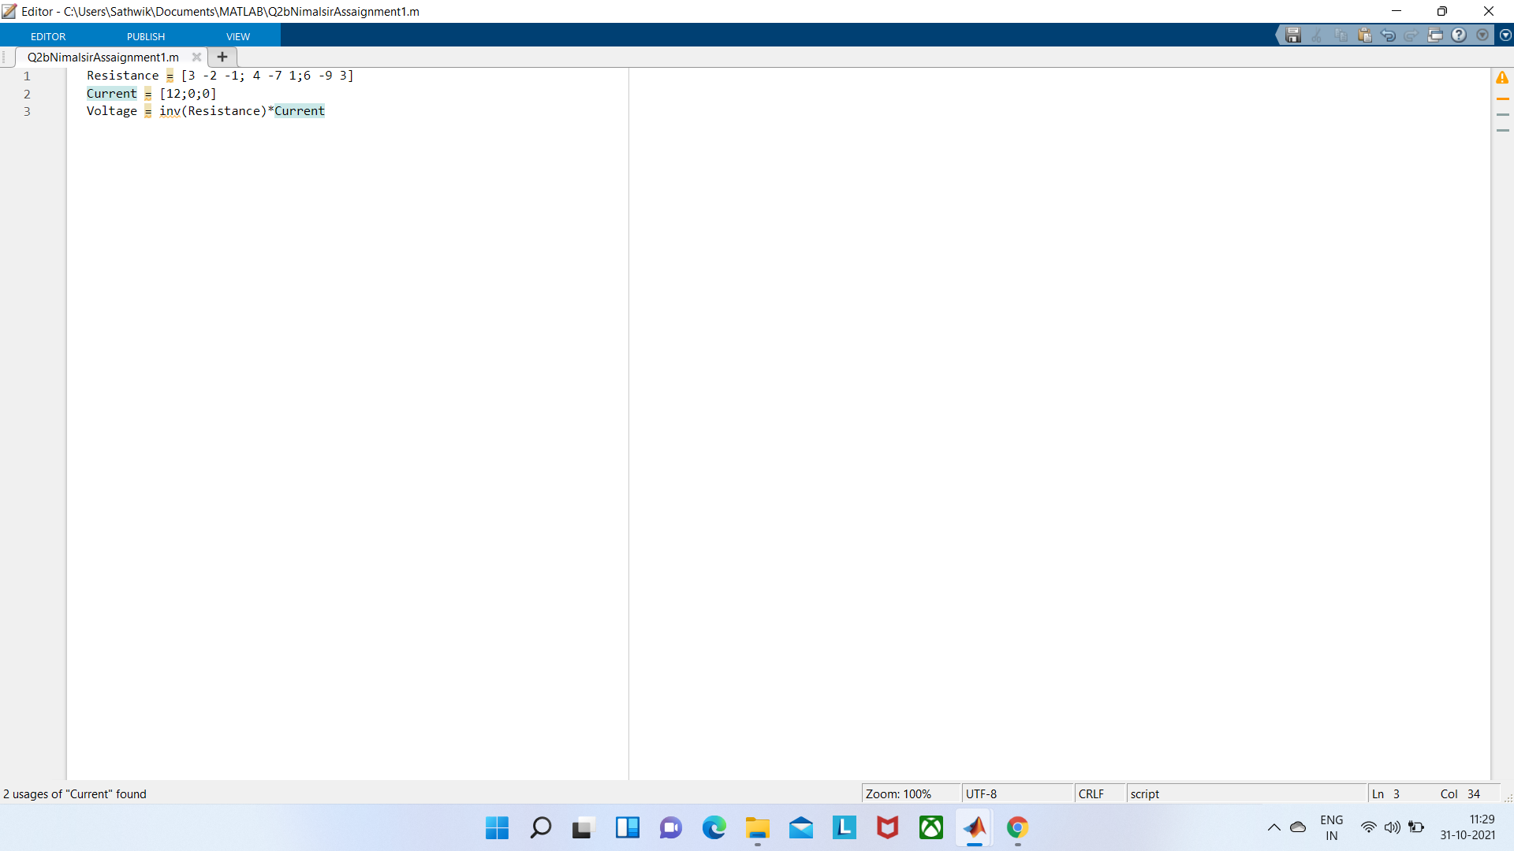
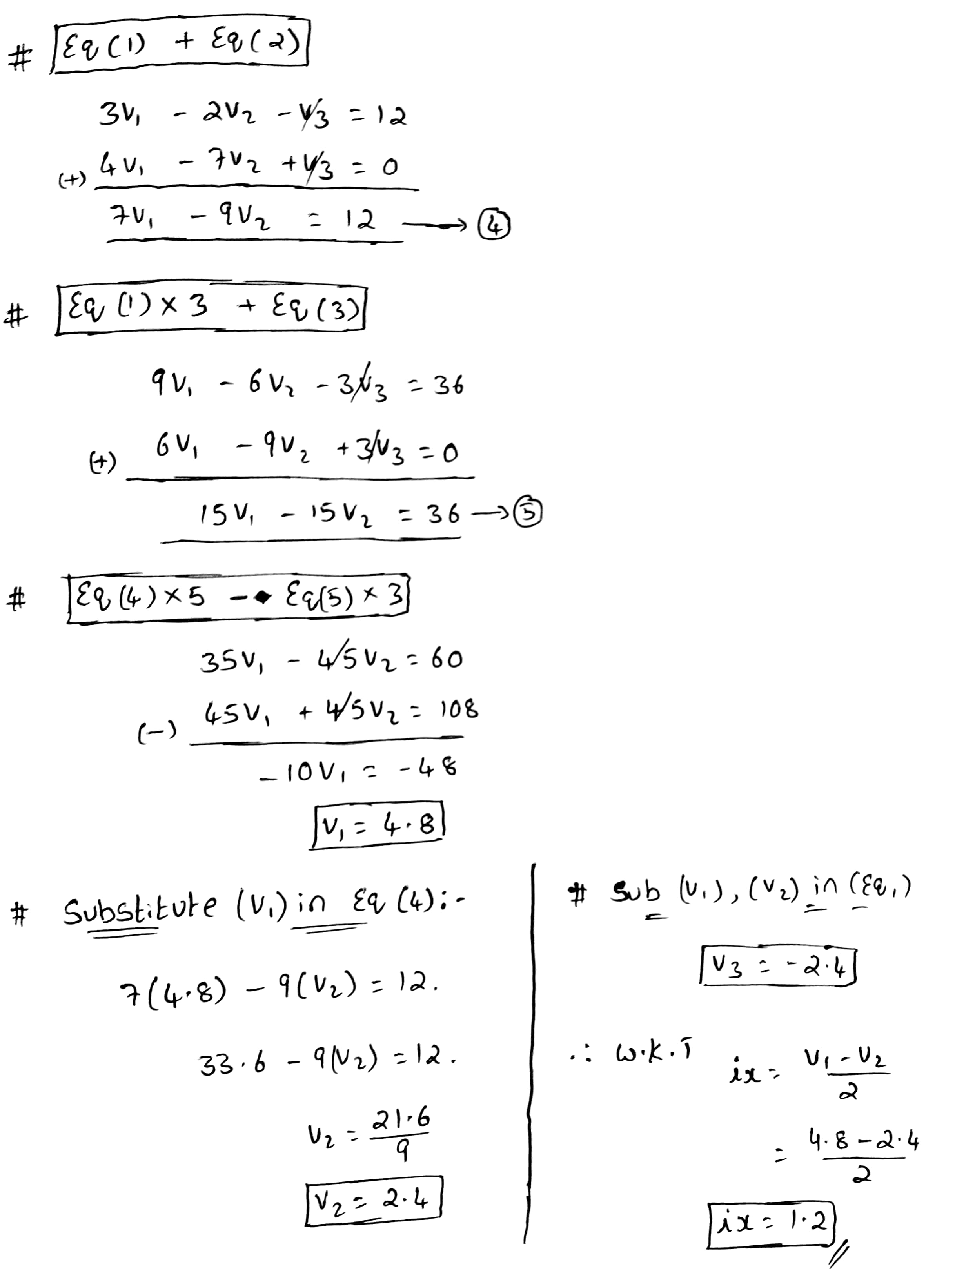
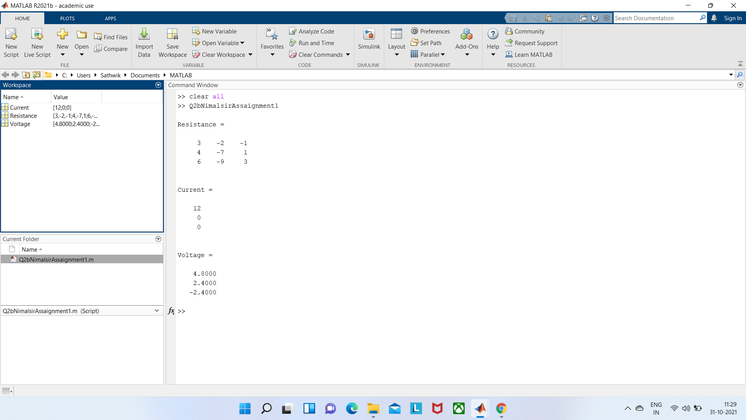
*Solving by matrix method using Matlab/octave *Solving using linear equations:
* v₁ = 4.8
* v₂ = 2.4
* v₃ = -2.4
* i_{x} = v₁ –v₂/2
* i_{x} = 1.2

Slide 21
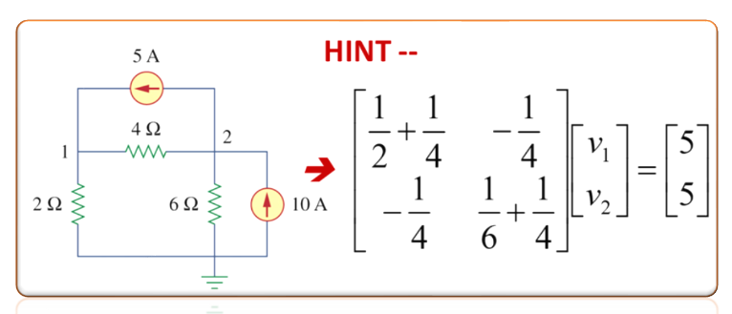
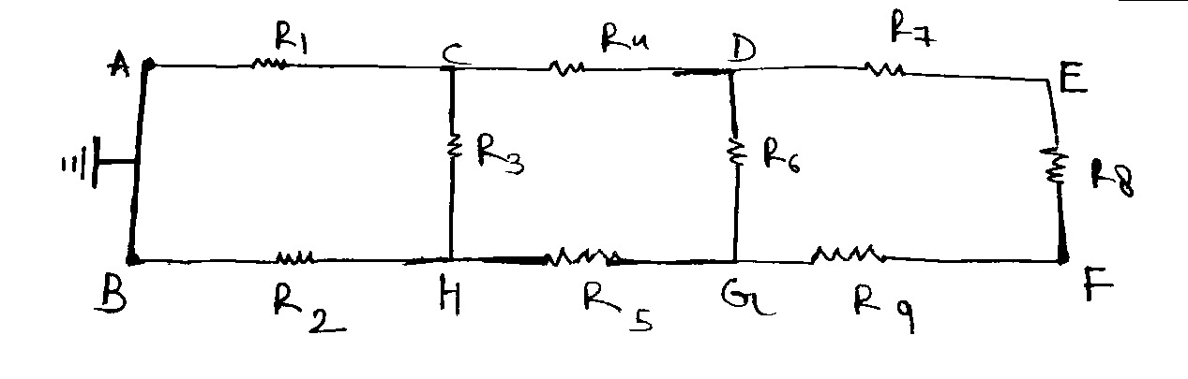
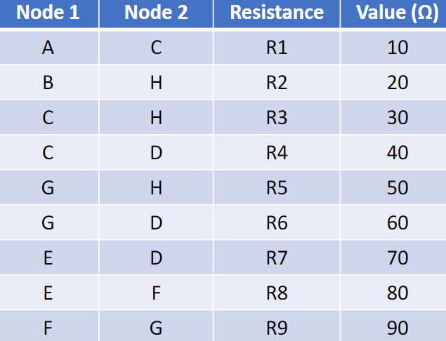
Q3.1.Construct the circuit described by the data given in Table.
From basic knowledge of Circuits we can create a circuit based on following data:-

Slide 22
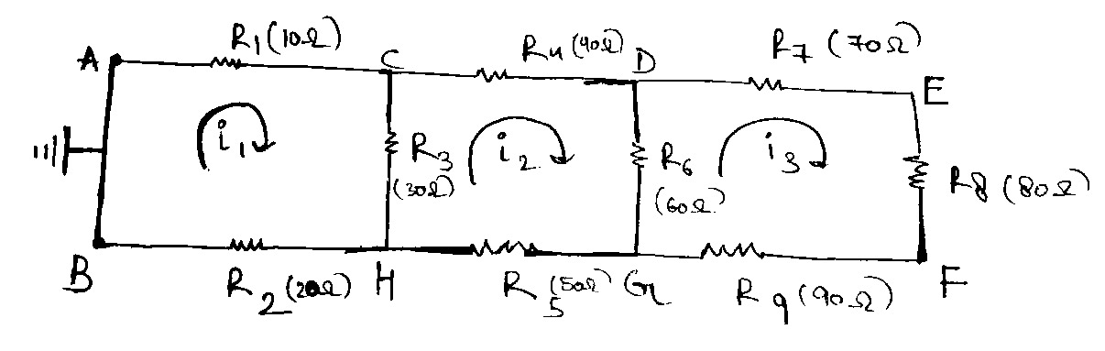
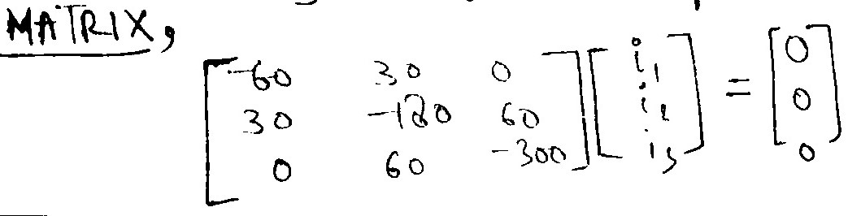
Q3.2 Create the mesh/nodal network matrix for the circuit.
Writing Equation for above circuit will give us:- Loop1 -10i₁-30(i₁-i₂)-20i₁=0 Loop 2
-40i₂-60(i₂-i₃)-50i₂-30(i₂-i₁)=0
Loop 3
-70i₃-80i₃-90i₃-60(i₃-i₂)=0
AFTER SOLVING FURTHER WE GET,
-60i₁+30i₂ = 0 - Eqn1
-180i₂+30i₁+60i₃ = 0 - Eqn2
-300i₃+60i₂ = 0 - Eqn 3

Slide 23
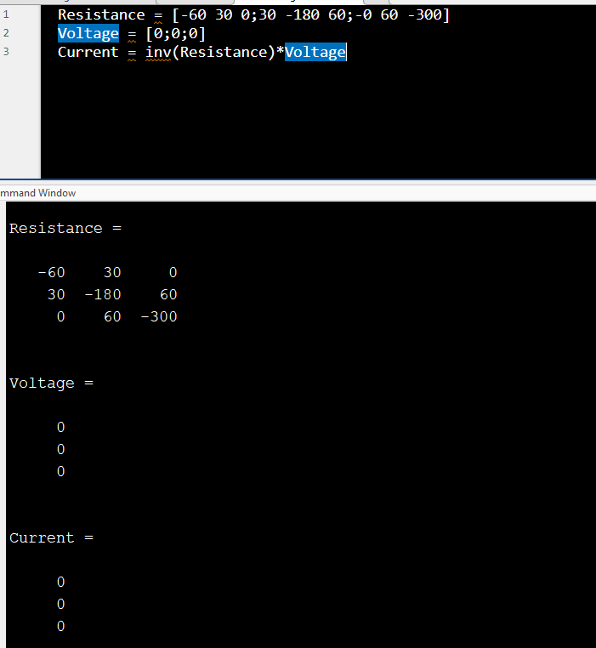
From three equations we get our matrix,
CREATING MATRIX USING MATLAB:- CODE FOR THE SAME ----------------------------------→
Final current will be zero in each loop will be zero→
i₁=0
i₂=0
i₃=0

Slide 24
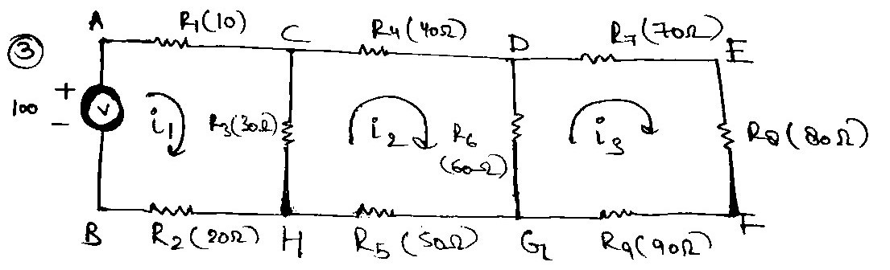
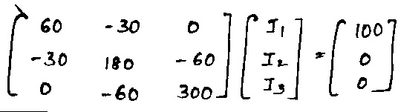
Q3.3.If the circuit is excited by a 100 V DC, write the MATLAB/Python code to solve the systems of equations in (2).
Writing Equation for given circuit using mesh analysis:
Loop 1
100-10i₁-30(i₁-i₂)-20i₁ = 0
Loop 2
-40i₂-60(i₂-i₃)-50i₂-30(i₂-i₁) = 0
Loop 3
-70i₃-80i₃-90i₃-60(i₃-i₂) = 0
After Solving further we get,
100-60i₁+30i₂ = 0 -Eqn1
30i₁-180i₂+60i₃ = 0 -Eqn2
-300i₃+60i₂ = 0 -Eqn3

Slide 25
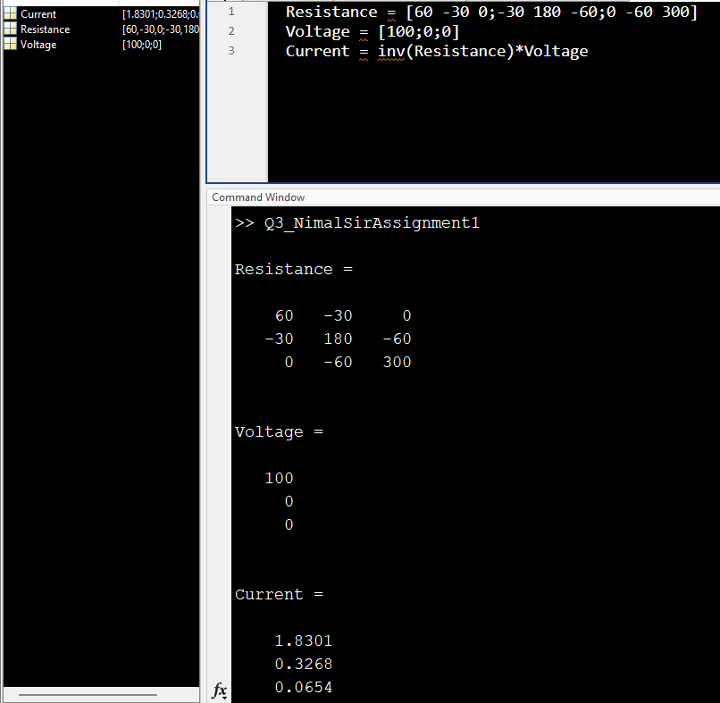
From three equations we get our matrix,
CREATING MATRIX USING MATLAB:-
CODE FOR THE SAME ----------------------------------→
From help of given image on right we will create
MATRIX in MATLAB:-
i₁=1.8301
i₂=0.3268
i₃=0.0654

Slide 26
Q4.
1. Formulate the network equations to demonstrate the transient operation of a parallel RLC circuit without EMF excitation.
2. Using MATLAB/Python, plot the transient nature of the current in a parallel RLC circuit without excitation. Provided C = 0.05, L = 0.55, R = 0 and the capacitor is charged to 8V in the beginning.
3. If a series RLC circuit (C = 0.05, L = 0.51, R = 0.15) is being excited by a step input signal of 10 V, {𝑉𝑠 0 = 0 𝑉, 𝑉𝑠 0 + Δ𝑡 𝑡𝑜 𝛼 = 10 𝑉}, plot the transient response using MATLAB/Python.

Slide 27
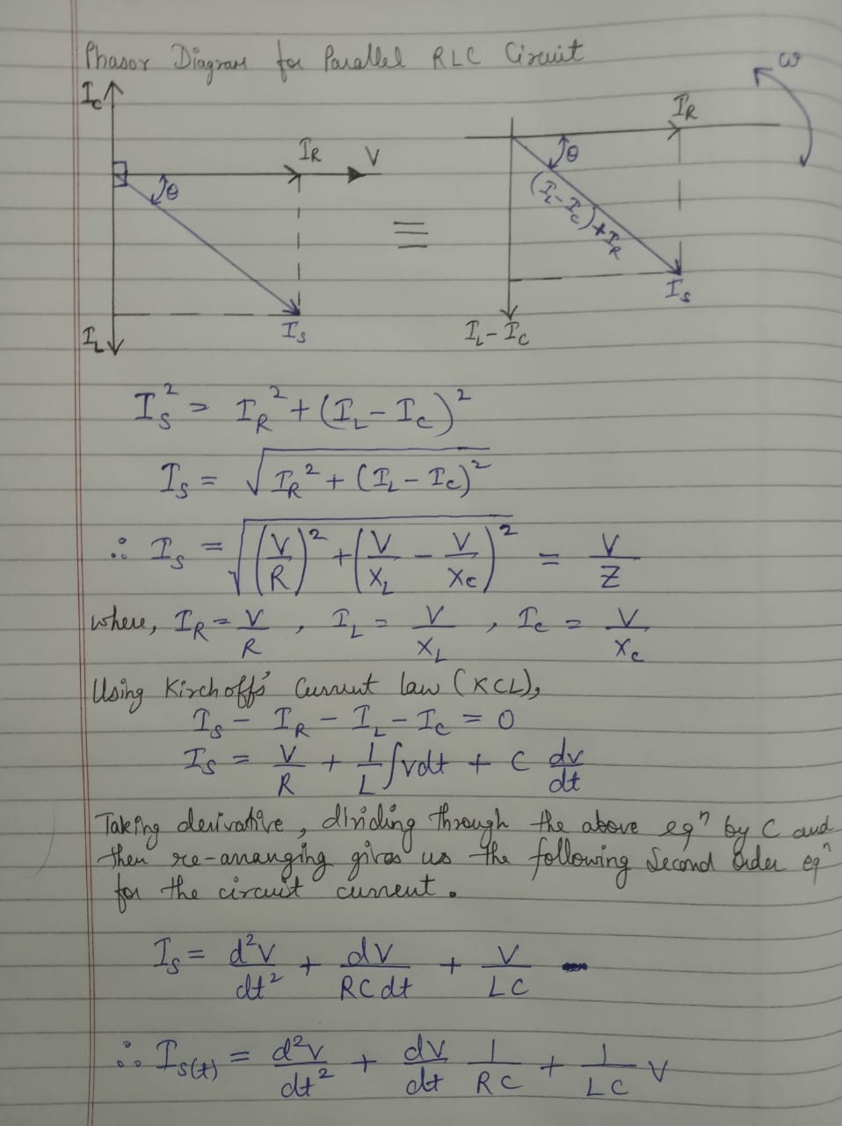
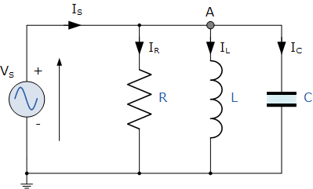
Ans 4.1

Slide 28
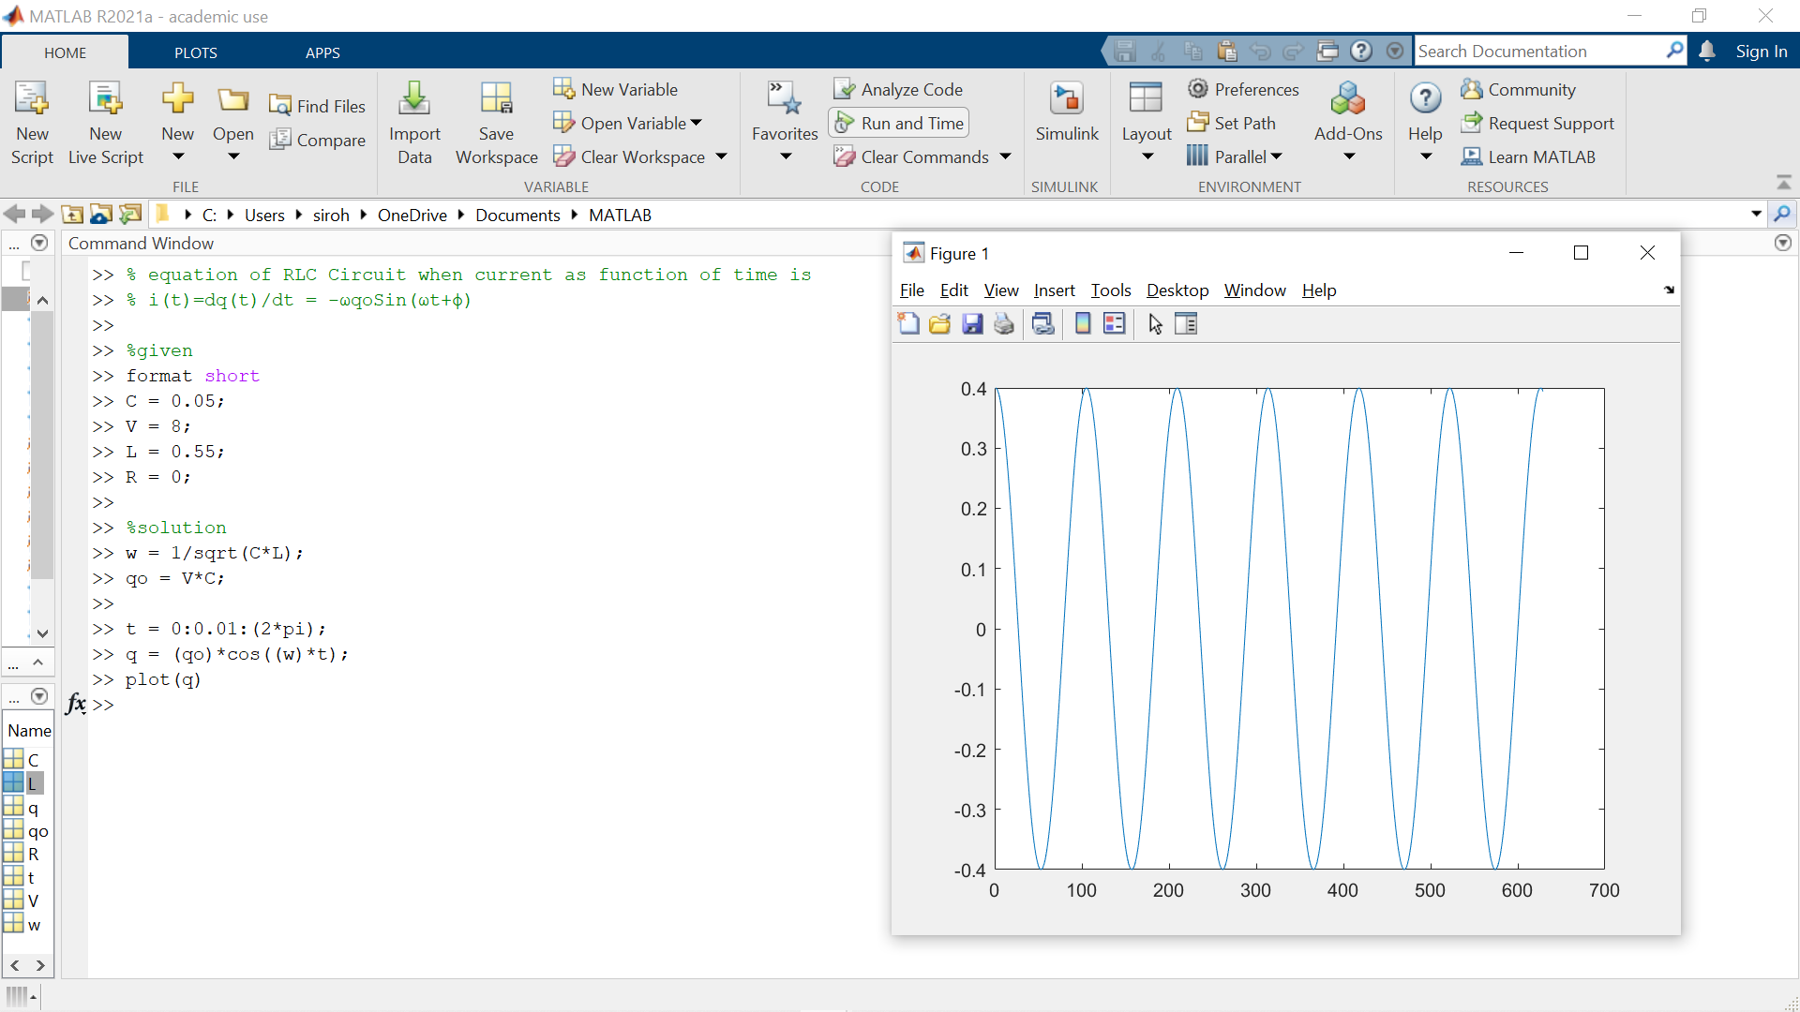
Ans 4.2

Slide 29
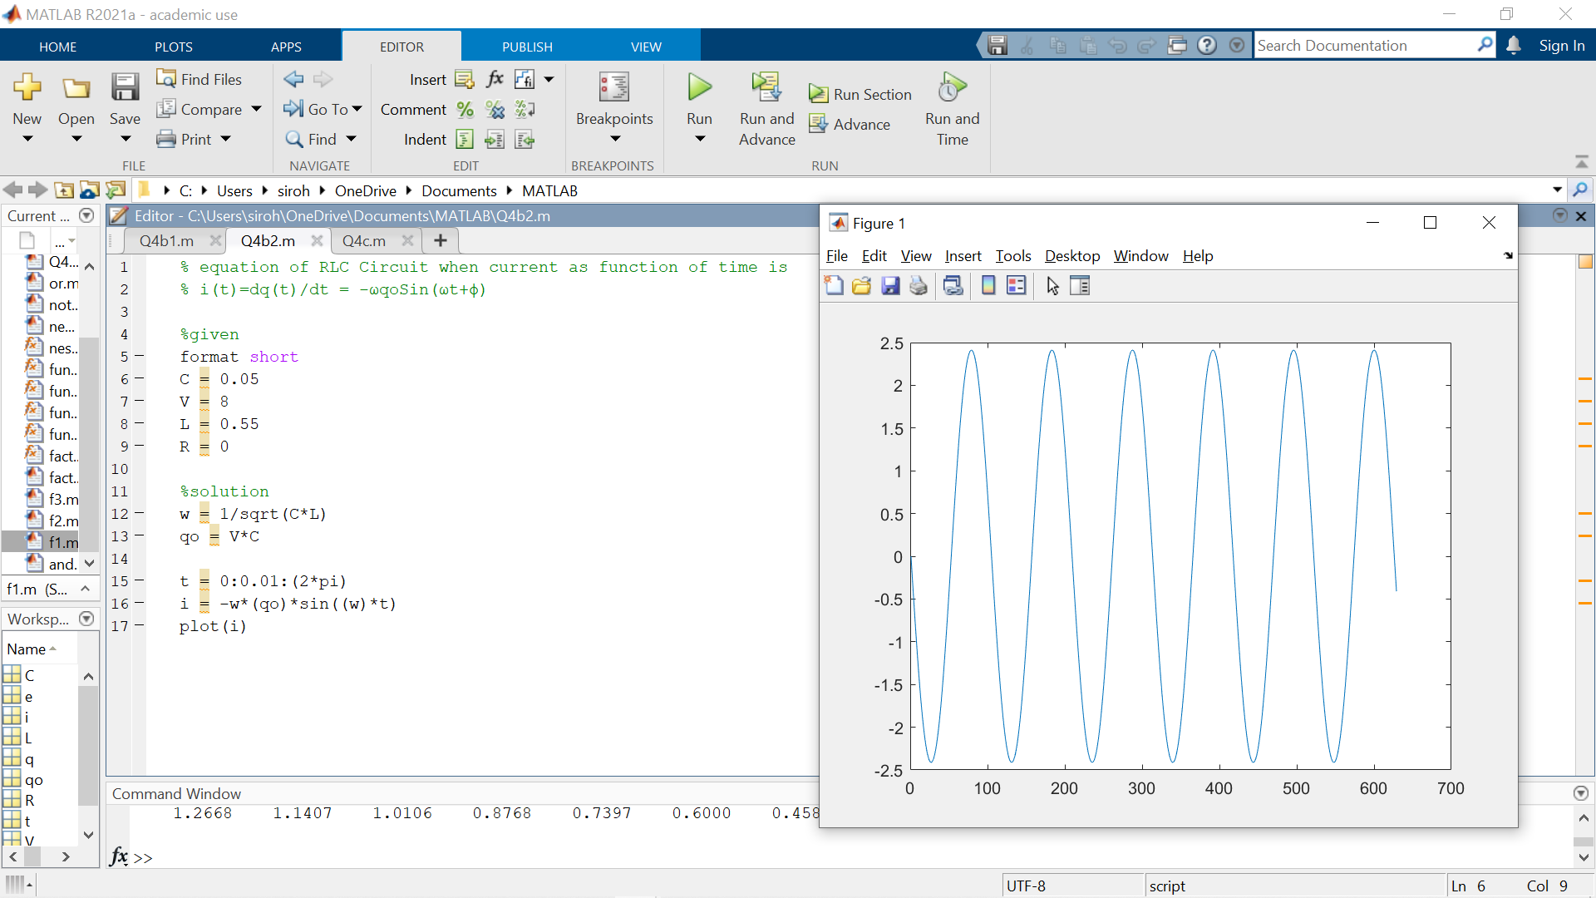

Slide 30
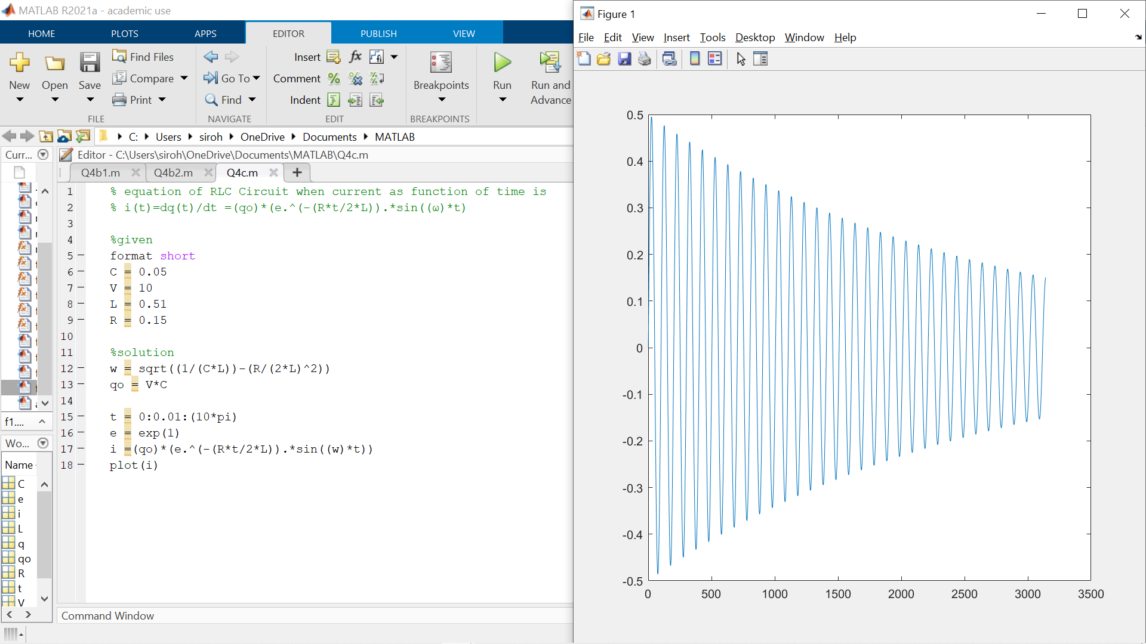
Ans 4.3

Slide 31
THANK YOU

